Slide 1
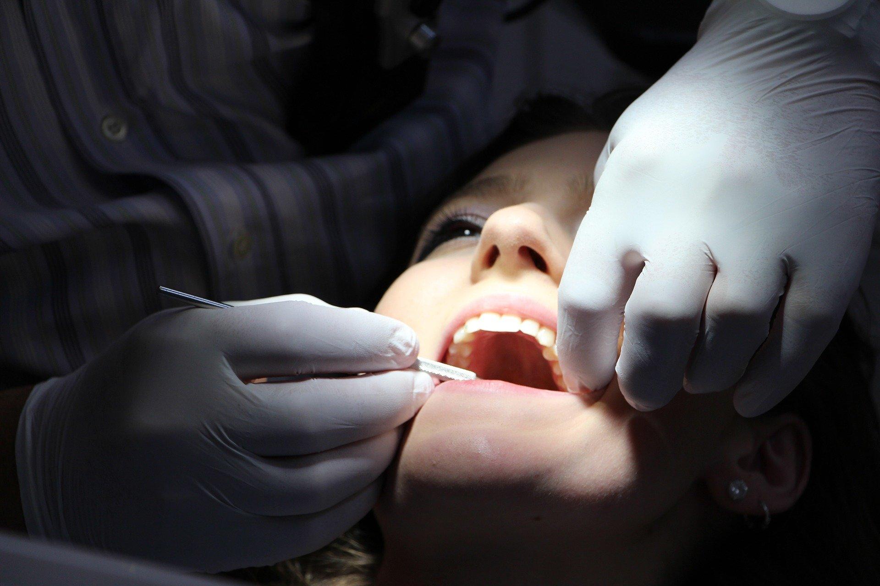
Controversies with Current Dental Prophylaxis Guidelines
Debbie Goff PharmD, FIDSA, FCCP
Professor of Pharmacy
Infectious Diseases Specialist
The Ohio State University Wexner Medical Center
@IDPharmD

Slide 2
Objectives
Share why and how we implemented dental stewardship
Discuss antibiotic prophylaxis in dentistry
impacts dentists, orthopedic surgeons, family practice, internal medicine, ID
Review Guidelines for Dental Antibiotic Prophylaxis for Prevention of Endocarditis and Prosthetic Joint Infections
Notes:
DG and JEM for 1 and 2

Slide 3
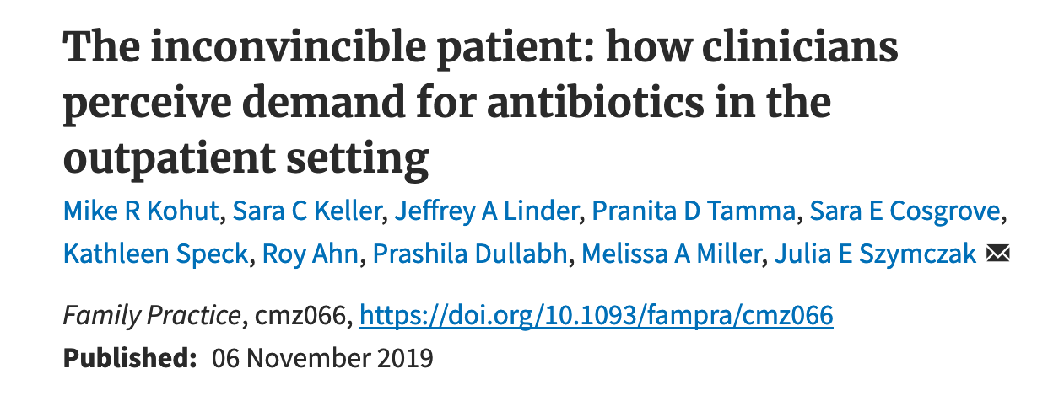
Outpatient ASP
Three related factors motivated clinically unnecessary antibiotic use in the face of perceived patient demand:
(i) clinicians want their patients to regard clinical visits as valuable and believe antibiotic prescription demonstrates value
(ii) clinicians want to avoid negative repercussions of denying antibiotics, damage to their reputation, emotional exhaustion, and degraded relationships with patients
(iii) clinicians believed that certain patients are impossible to satisfy without an antibiotic prescription

Slide 4


Real story
Patient “stuck in the middle”
Dentist
Orthopedic
Surgeon
Joint implant patient

Slide 5
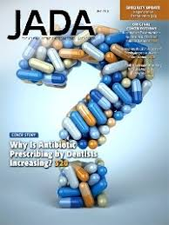
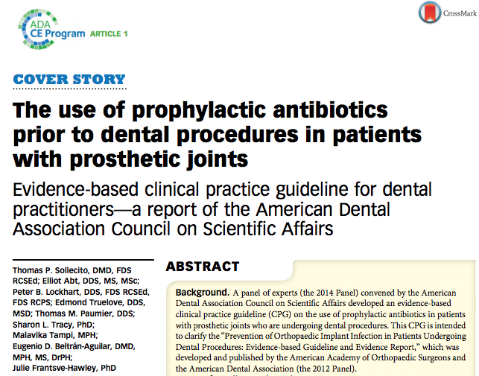
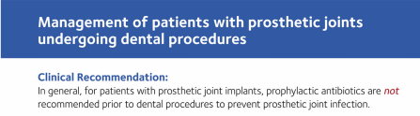
2015

Slide 6
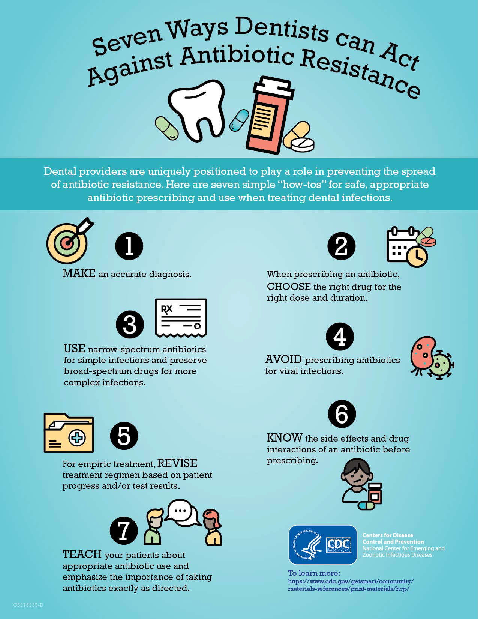
CDC Dental Stewardship
Dentists prescribe approximately 10% of all outpatient antibiotic prescriptions,
writing more than 25.7 million prescriptions per year.
CDC dental ASP work is with VA data
80% of US dentists are in private practice
By 2030, primary total hip and knee replacement is projected
to grow to 1.9 million procedures total in US
If each TJI patient visits the dentist twice a year to have their
teeth cleaned and receives AP, that represents a potential
3.8 million AP prescriptions a year, of which the ADA states
“in general are unnecessary”

Slide 7
Evolution of guidelines for dental antibiotic prophylaxis (AP) to prevent infective endocarditis (IE)
1955 AHA | AP for many patients to prevent streptococcal infections
1990 AHA | Recognition of medical legal risks associated with IE and “intended as a guideline not as established standard of care”.
1997 AHA | AP limited to only pre-operative timing; amoxicillin 2 gm orally, one hour before
2007 AHA and ADA | AP for fewer conditions than in 1997; only for highest risk patients Maintain optimal oral health for daily activities which is more important than AP for a dental procedure to reduce IE risk
2017 AHA/ACC | AP was expanded to include: patients with transcatheter prosthetic valves and patients with prosthetic material used for valve repair such as annuloplasty rings and chords.
2018 Health Insurance Database in Taiwan from 2005-2011 | No clinically significant association between dental treatment and risk of IE; no evidence to support antibiotic prophylaxis for any patients, even high risk

Slide 8
Evolution of guidelines for dental antibiotic prophylaxis (AP) for PJI patients
1997 ADA and AAOS | AP for patients at potential increased risk of PJI: 1- Immunocompromised due to inflammatory arthropathies or disease/ drug/ radiation 2-Type 1 DM, first 2 years post joint replacement, previous PJI, malnourished and hemophilia. 3. AP is not indicated for patients with pins plates or screws and is not routinely indicated for most patient with TJR.
2003 ADA and AAOS | “AP for at risk patients no longer includes ALL patients during the first 2 years after TJR.” Immunocompromised now include: HIV infection and malignancy Included incidence stratification of dental procedures as high and low risk
2009 AAOS | consider AP for ALL TJR prior to any invasive procedure that may cause bacteremia, because any invasive procedure can cause bacteremia
2013 ADA and AAOS | AAOS reversed itself Clinicians should consider discontinuing the long-standing practice of routinely prescribing AP for patients with PJI
2015 ADA | “In general, for patients with prosthetic joint implants, AP is not recommended to prevent PJI; prophylactic antibiotic should not be given.” Consider preferences of each patient.
2017 AAOS and ADA | Among 64 scenarios created to determine if AP is appropriate 61% rarely appropriate Clindamycin for penicillin allergy is replaced by azithromycin

Slide 9

Controversies in Dental Antibiotic Prophylaxis

Slide 10
Myths of Dental-Induced Prosthetic Joint Infections
The first myth
is that there are close similarities between late prosthetic valve endocarditis and late PJI
The second myth
is that dental treatment is the probable cause of a large percentage of PJI
The third myth
is that results of animal experiments have shown that transient bacteremia due to dental procedures can cause PJI in humans.
The fourth myth
is the benefits of antibiotic prophylaxis for patients with prosthetic joints outweigh the risks and costs.
The fifth and final myth
is that clinicians should recommend antibiotic prophylaxis before dental treatment for patients with prosthetic joints to protect themselves legally.
Wahl M. 1995 Clin Inf Dis 20:1420-5

Slide 11

How do you change orthopedic surgeons habit of recommending dental antibiotic prophylaxis for life?

Slide 12
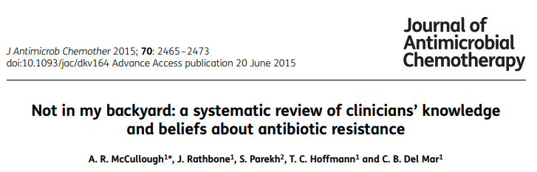
“Clinicians believe antibiotic resistance is a serious problem, but think
it is caused by others.”

Slide 13
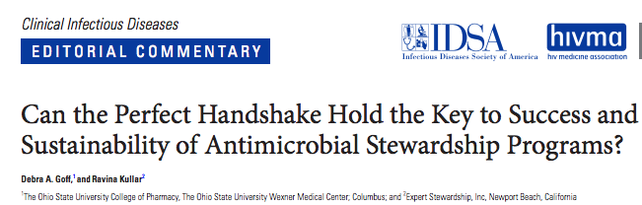

Notes:
Handshake Stewardship does not use prior authorization, but rather, the ASP physician and pharmacist reviews all antimicrobials at 2 time points (24 and 48–72 hours) and then makes daily rounds. They meet and greet clinicians with a “perfect handshake” and then make their recommendation and intervention.
A 23% sustained reduction in antibiotic use was observed post implementation year 5 (P < .001).

Slide 14

“Know and Trust the Steward”
“ASP recommendations are made to doctors who are not seeking our advice. It is easy to dismiss ASP when there is no professional relationship.”
ASP interventions must be tailored to professional identities of different medical specialists in order to change the culture of antimicrobial prescribing
ASP pharmacist RK developed a trusting
relationship with the famous TV plastic surgeon
Dr. Nassif.
He changed his antibiotic prescribing
And they co-authored a paper to educate
other plastic surgeons.

Slide 15
“Know and Trust the Steward”
Columbus OH Dental ASP
Dentist:
my husband
Orthopedic surgeon:
my neighbor
OSU faculty and CDC physicians

Slide 16
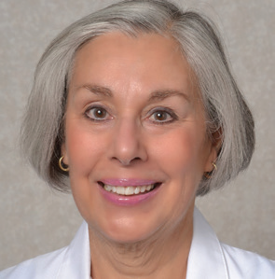
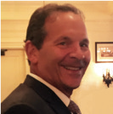

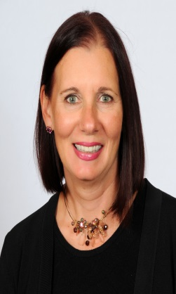
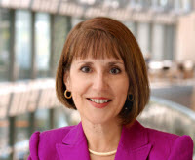
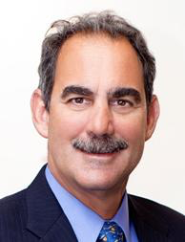
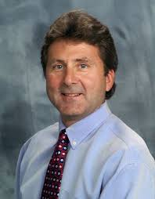
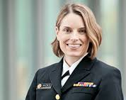
Dental Antibiotic Stewardship
Debbie Goff, PharmD, FIDSA, FCCP
ID Specialist, OSU Wexner Medical Center Professor of Pharmacy
College of Pharmacy
Julie E. Mangino,
MD, FSHEA
Professor Emeritus,
College of Medicine
Division of Infectious Diseases
Andrew H. Glassman, MD, MS
Professor and Chairman,
Department of Orthopaedics;
Frank J. Kloenne Endowed
Chair of Orthopaedic
Surgery, Wexner Medical Center
Peter E. Larsen, DDS, FACS
Professor and Chair of Oral and Maxillofacial Surgery and Dental Anesthesiology,
The Larry J. Peterson endowed Professor of Oral
and Maxillofacial Surgery,
College of Dentistry and
The OSU Wexner Medical Center
Denise Cardo, MD
Director of the Division of Healthcare Quality Promotion
National Center for Emerging and Zoonotic Infectious Diseases
Lauri Hicks DO
Captain in the US Public Health Service
Director for Office of Antibiotic Stewardship
Rick Scheetz, DDS MS
Oral & Facial Surgeons of Ohio
Doug Goff, DDS MS
Prosthodontist

Slide 17
Dinner Meeting
Dinner (Education)
OSU faculty, CDC, Private practice dentists
Breakout into working groups (Peer pressure, Trust the steward)
dentists and orthopedic surgeons
Group presentations and discussion (Behavior change)

Slide 18
antibiotic stewardship
Overseeing something worth protecting
Antibiotic resistance is not just an infectious disease issue;
it is a surgical issue, a cancer issue, a dental issue, a patient issue.
Notes:
How do we become part of the solution to preserve the miracle drug called antibiotics? The answer is Antibiotic Stewardship. Stewardship is overseeing something worth protecting. We must ALL become stewards of antibiotics

Slide 19
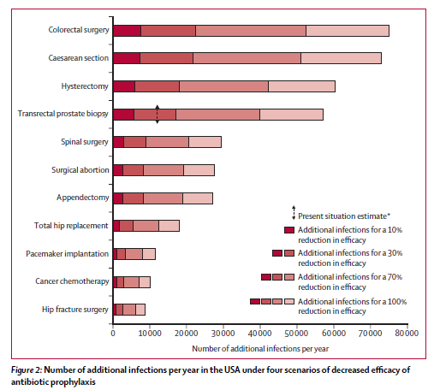
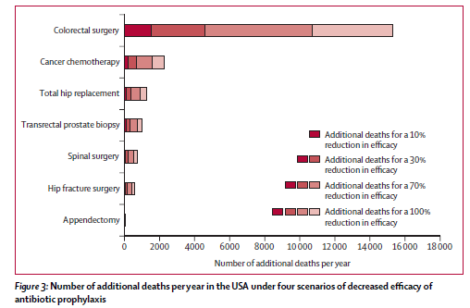
Impact of antibiotic resistance on prophylaxis
Additional infections per year
Additional deaths per year
Ref: Lancet Infect Dis 2015; 15: 1429–37
Notes:
We assessed 10%, 30%, 70%, and 100% reductions in antibiotic efficacy by comparison with effect sizes in
randomised controlled trials done between 1968 and 2011.

Slide 20
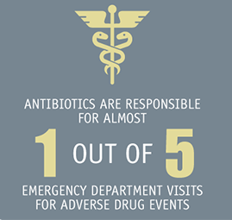
Benefit
prevent PJI infection
perceived as “safe” drugs
“just-in-case” mentality
Risk
1. C. difficile
Quality of life issues with recurrent Cdiff
Death from Cdiff
2. Antibiotic resistance
3. Adverse drug reaction
antibiotics ADR are #1 drug for ED visit
Tamma JAMA 2017 (177)1308-15.
Ref: Mehrotra A. et al JAMA September 19, 2016 doi:10.1001/jamainternmed.2016.6254

Slide 21
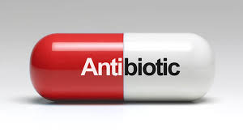
One dose of clindamycin has an equivalent risk of C difficile compared with a prolonged course
Thornhill MH, Dayer MJ, Prendergast B, Baddour LM, Jones S, Lockhart PB. Incidence and nature of adverse reactions to antibiotics used as endocarditis prophylaxis. J Antimicrob Chemother. 2015;70(8):2382-2388

Slide 22
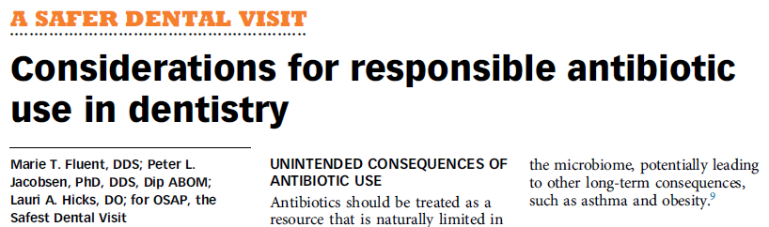
American Dental Association
2016 evidence based guideline
JADA 147(8) http://jada.ada.org August 2016
CONCLUSIONS
“In general, for patients with prosthetic joint implants, prophylactic antibiotics are not recommended prior to dental procedures to prevent prosthetic joint infection.”
JADA 2017 Editorial http://dx.doi.org/10.1016/j.adaj.2016.12.002

Slide 23
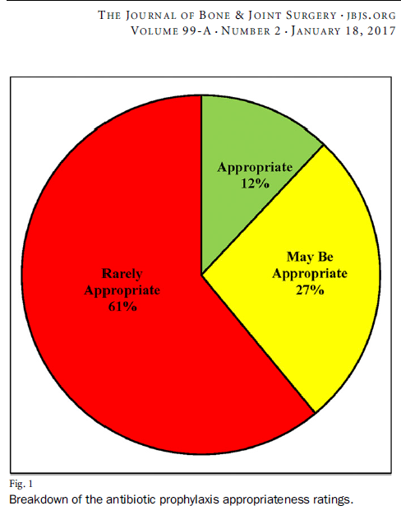
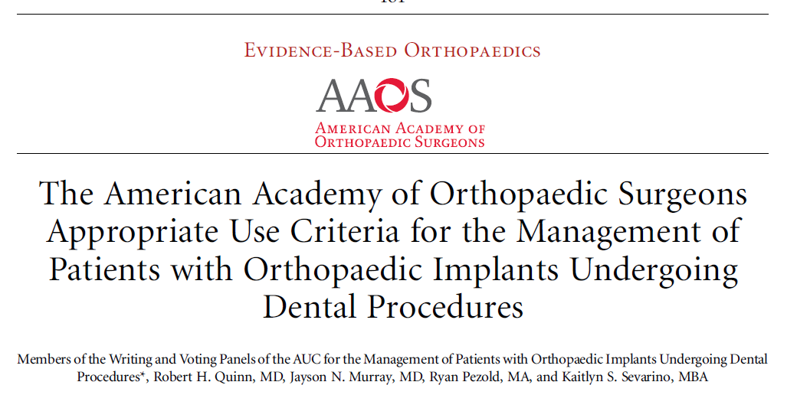
American Academy of Orthopaedic Surgery

Slide 24
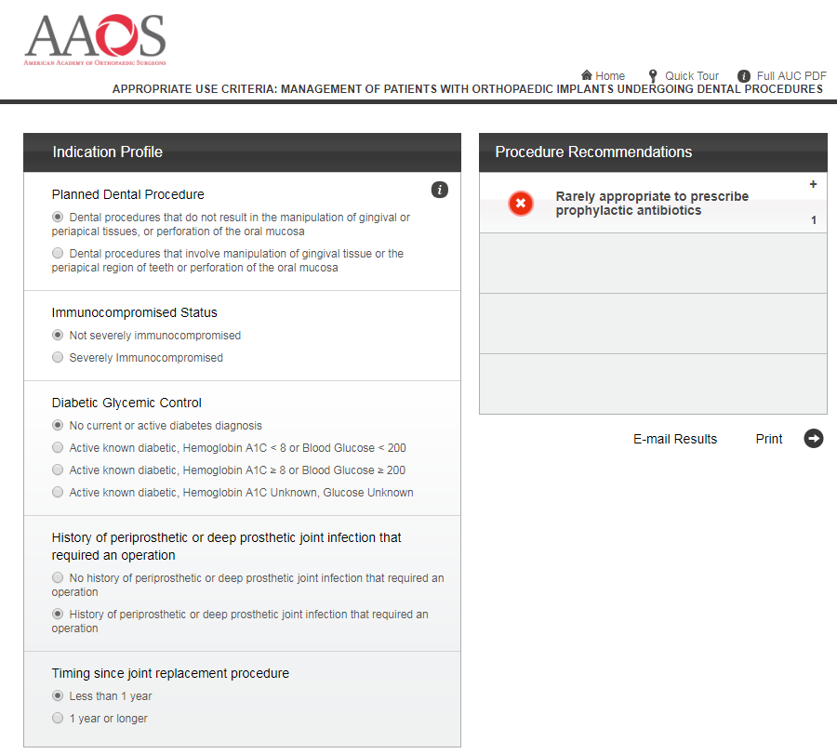

Not a single orthopedic surgeon or dentist had seen it let alone used it.
What risk calculator?
http://www.orthoguidelines.org/go/auc/auc.cfm?auc_id=224995

Slide 25
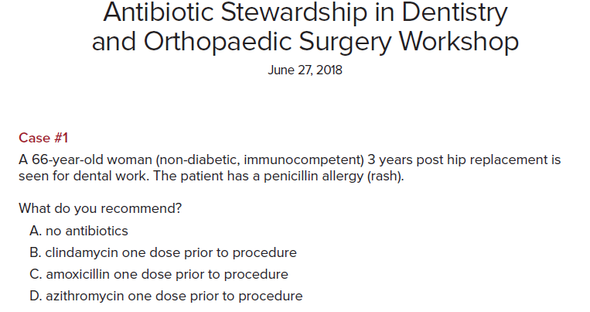

Slide 26
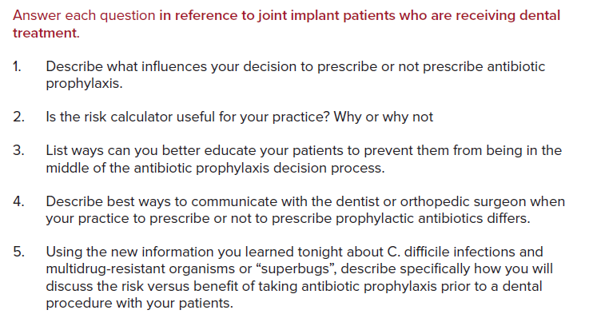

Slide 27
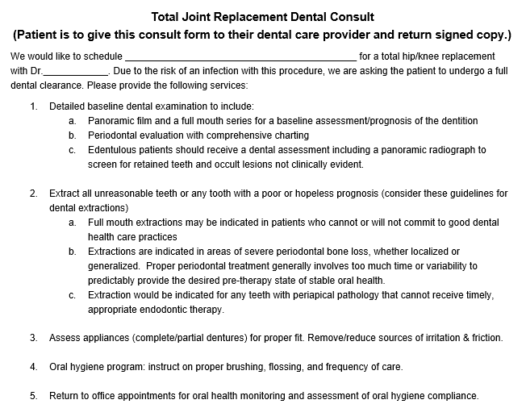

Slide 28

Orthopedic Surgeon
“If you asked me yesterday, I would say the patient in case one should receive dental antibiotic prophylaxis for her lifetime. Tonight, I learned new information and I will no longer recommend prophylaxis in this type of patient.” Orthopedic surgeon
“I only use oral AP so my patient can not get C. difficile infection.”
“You just need to be burned once from a PJI after a dental procedure then you treat everyone else the same with antibiotic prophylaxis, regardless.
“ I really never thought how disruptive it is for the dentist when my patient shows up demanding AP before their dental procedure and expects the dentist to track me down to call in a prescription. Now that we met each other I’ll make sure to respond.”

Slide 29

Dentist
“I don’t know how well controlled the patients’ diabetes mellitus is and neither does the patient. The risk calculator is useless.” Dentist
“At my office appointment, I am calling their primary care physician or orthopedists and if I don’t, the patient is stuck in the middle in my office hoping to get their dental work done.”
“I enjoyed the opportunity to interact with our own community orthopedic surgeons and listen to different perspectives other than our own (and the ADA’s) on antibiotic prophylaxis”
“My discussion with the oncologic orthopedic surgeon in my group provided a new perspective and understanding for use of antibiotic prophylaxis in his patients.”

Slide 30

Dentist
Orthopedic Surgeon
2 Hospital lawyers
Fear of lawsuits
75% of dentists and 88% of OS prescribe antibiotic prophylaxis
as “defensive” medicine

Slide 31
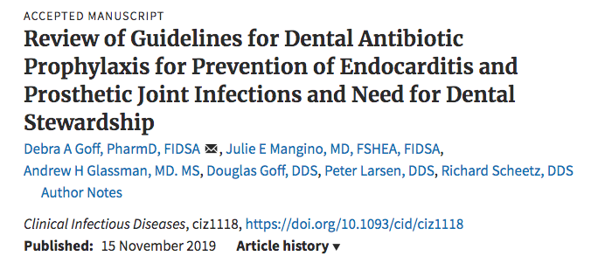



Slide 32
Most ASP strategies are aimed at changing doctors’ prescribing behavior; however, strategies are needed to also address patients’ behavior.
Patients’ expectations influence a doctor’s decision making.

Slide 33
Controversies with dental antibiotic prophylaxis
How can we resolve them?
Patient engagement
let the patient decide about taking AP once they have the facts
Dentists and OS need to know when their patients develops CDI
Dentists and OS need to know when their patient develops an ADR
Private practice doctors prefer online CE

Slide 34
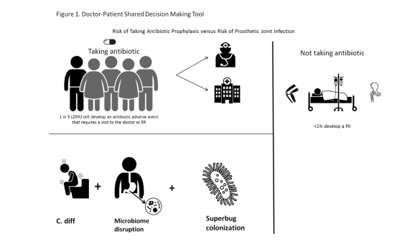

Slide 35
Take aways
Recommendations for dental AP for patients who have undergone cardiac procedures to prevent IE has essentially remained the same since 2007.
High risk: prosthetic cardiac valves or materials for valve repair, prior IE, more limited CHD (unrepaired cyanotic, completely repaired defects with prosthetics during the first 6 months, repaired CHD with residual defects at or near the site of the patch) and cardiac transplant recipients with cardiac valvulopathy, transcatheter prosthetic valves and patients with prosthetic material used for valve repair such as annuloplasty rings and chords
Guidance for AP for patients with a TJR are generally not recommended by dentists, yet are “preferred” by many orthopedic surgeons.
Similar to the current US opioid crisis which has greatly impacted clinicians to reconsider every opioid dose and duration we believe community based dental stewardship must advocate for both dentists and orthopedic surgeons to rethink any AP prescribed with a goal towards far less.

Slide 36
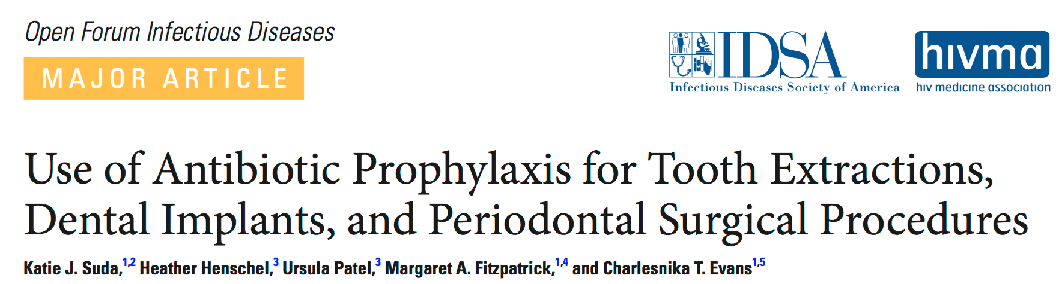
A cross-sectional study of veterans undergoing tooth extractions, dental implants, and periodontal procedures
183 veterans, 82.5% received antibiotic prophylaxis (mean duration, 7.1 ± 1.6 days).
Amoxicillin (71.3% of antibiotics) and clindamycin (23.8%) were prescribed most frequently
44.7% of patients prescribed clindamycin were not labeled as penicillin allergic.
Peggy Lillis Foundation
While the majority of antibiotics were indicated, only 8.2% of patients received antibiotics appropriately. The primary reason was secondary to prolonged duration.
Open Forum Infectious Diseases, Volume 5, Issue 1, Winter 2018

Slide 37

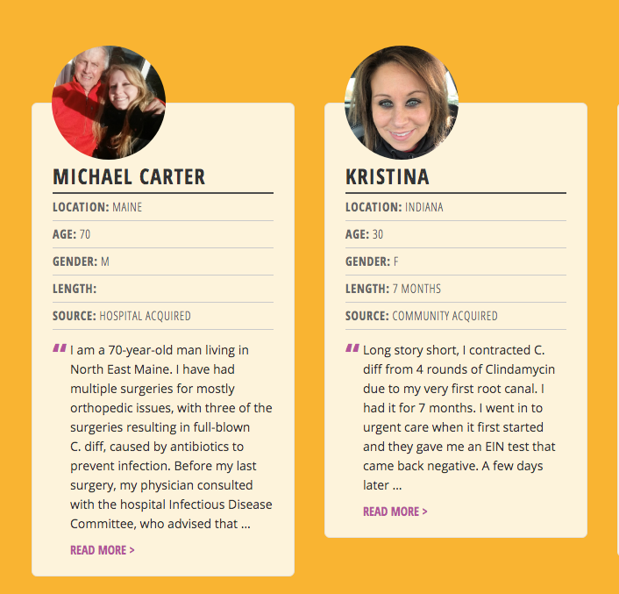
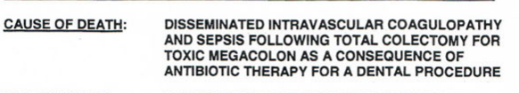
C. Diff advocacy, awareness, education & policy

Slide 38
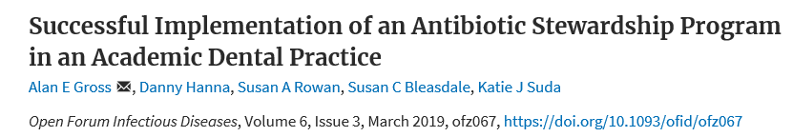
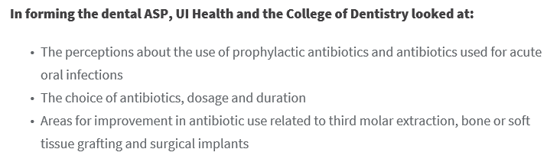

Slide 39
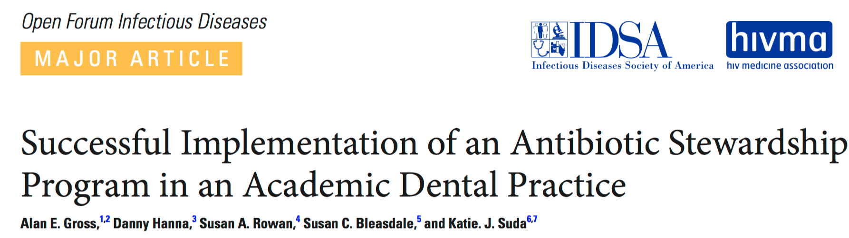
A collaborative team of dentist, pharmacist, and physician leaders conducted a baseline needs assessment to identify opportunities to improve antibiotic prescribing by dentists within Illinois’ largest oral health care provider for Medicaid recipients.
We identified multiple needs, including standardization of antibiotic prescribing practices for patients with acute oral infections in the urgent care clinics.
A 72.9% decrease in antibiotic prescribing was observed in urgent care visits a er implementation of our multimodal intervention
Open Forum Infectious Diseases, Volume 6, Issue 3, March 2019, ofz067,

Slide 40
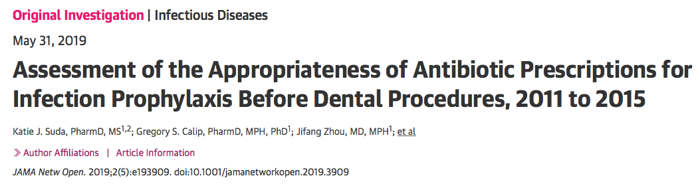
First national evaluation of prophylactic antibiotic use for IE and PJIs before dental procedures (26,200 views)
Assessed the appropriateness of antibiotic prophylaxis for IE and PJIs before dental procedures using Truven MarketScan database between 2011-2015. (168,420 dental visits with antibiotics)
What percent of antibiotics prescribed for IE and PJI prophylaxis before dental procedures were unnecessary?

Slide 41
80.9%
of antibiotic prophylaxis prescriptions were discordant with guidelines

Slide 42
Reasons for high antibiotic prescribing rates
slow adoption of new guidelines
lack of awareness of the role of dentists in antibiotic resistance
physician and patient pressure

Slide 43
Recommendation
Specific antibiotic stewardship strategies and prescribing tools targeted to dentists should be
developed, implemented, and assessed for effectiveness in improving prescribing of antibiotics for infection prophylaxis before dental procedures
Who will do this?

Slide 44
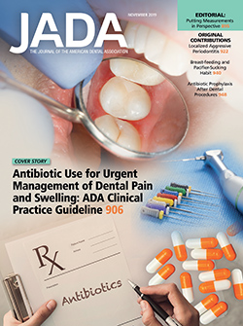
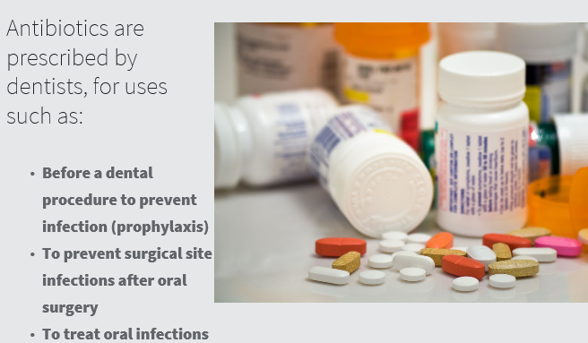

Slide 45
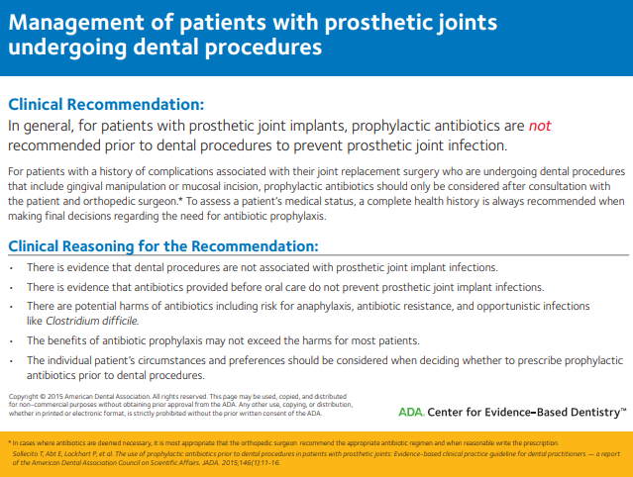

Slide 46
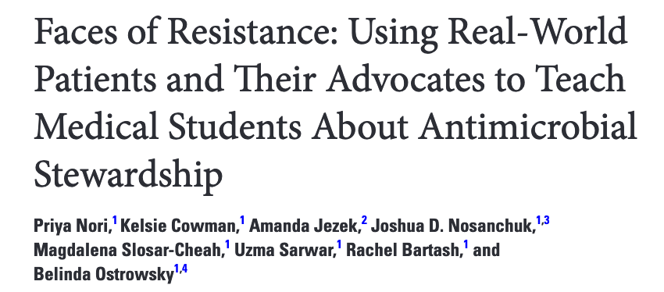
Engaging Patients in ASP
We engaged medical students with antimicrobial stewardship (AS) and antimicrobial resistance (AMR) through patient stories and a panel on AMR advocacy with experts from the Centers for Disease Control and Prevention and the Infectious Diseases Society of America.
We hope to inspire students to tackle the next generation of ID challenges, through innovations in medical education, personal connections with patients, and instruction by enthusiastic faculty members
Ref: Nori et al. OFID Volume 6, Issue 12, December 2019, ofz487, https://doi.org/10.1093/ofid/ofz487

