Slide 1
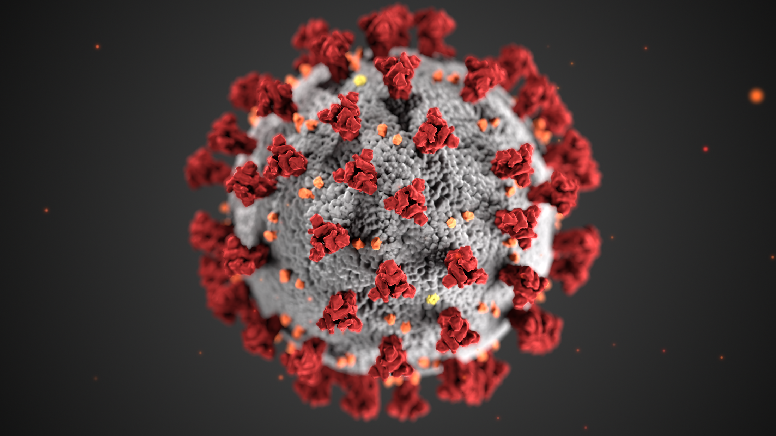
COVID-19: Infectiousness & Mitigation Strategies
Natasha Mubeen Chida, MD MSPH
Division of Infectious Diseases
Johns Hopkins University School of Medicine

Slide 2
Objectives
Discuss data on timing of peak infectiousness
Viral dynamics
Data on symptoms and correlation to culture positivity
Ct value correlation to culture positivity
Describe data on masks, distancing, eye protection mitigation measures in
Community
Healthcare Settings
Home
Not discussing aerosols/droplets/conditions promoting transmission/attack rates
Dr. Klompas 10/15

Slide 3
Part 1: Timing of Peak Infectiousness and Isolation
Part 2: Mitigation of transmission

Slide 4
Timing of Peak Infectiousness and Isolation

Slide 5
Questions
When are patients with COVID-19 most infectious?
When can transmission-based precautions be discontinued?
What data supports these recommendations?
https://news.mit.edu/2014/coughs-and-sneezes-float-farther-you-think

Slide 6
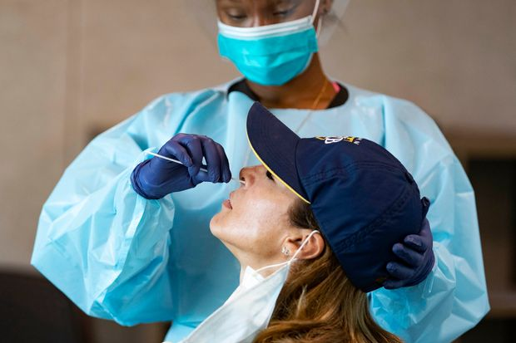
CDC Guidance
Updated August 2020
Symptom based strategy, as opposed to test based
Important clinical characteristics to consider
Disease severity
Immune compromised status
https://www.wsj.com/articles/covid-19-tests-answers-on-cost-accuracy-and-turnaround-time-11599134378

Slide 7
Clinical characteristics | Can discontinue transmission based precautions if…
Asymptomatic, not severely* immune compromised | At least 10 days have passed since first positive test
Asymptomatic, severely immune compromised | At least 10 – 20 days have passed since first positive test
Mild/Moderate illness, not severely immune compromised | At least 10 days have passed since symptoms first appeared and At least 24 hours have passed since last fever without the use of fever-reducing medications and Symptoms (cough, shortness of breath) have improved
Severe/Critical disease OR severely immune compromised** | At least 10 days and up to 20 days have passed since symptoms first appeared and At least 24 hours have passed since last fever without the use of fever-reducing medications and Symptoms (cough, shortness of breath) have improved Consider consultation with infection control experts
*Severely immune compromised: on chemotherapy for cancer, within one year out from receiving a HSCT or SOT, untreated HIV infection with CD4 T lymphocyte count < 200, combined primary immunodeficiency disorder, and receipt of prednisone >20mg/day for more than 14 days
** Can consider a test-based strategy
https://www.cdc.gov/coronavirus/2019-ncov/hcp/disposition-hospitalized-patients.html
Notes:
Mild: Signs and symptoms of COVID-19 without shortness of breath, dyspnea, or abnormal chest imaging.
Moderate: Evidence of lower respiratory disease by clinical assessment or imaging, and a saturation of oxygen (SpO2) ≥94% on room air at sea level.
Severe: Respiratory frequency >30 breaths per minute, SpO2 <94% on room air at sea level (or, for patients with chronic hypoxemia, a decrease from baseline of >3%), ratio of arterial partial pressure of oxygen to fraction of inspired oxygen (PaO2/FiO2) <300 mmHg, or lung infiltrates >50%.
Critical: Respiratory failure, septic shock, and/or multiple organ dysfunction.

Slide 8
Viral Dynamics, Culture, and Symptoms

Slide 9
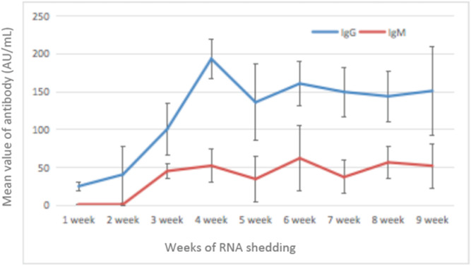
Persistence of Viral RNA Shedding
378 patients diagnosed with COVID‐19
Review of EMR
Median age of the patients 57.5 years (IQR 52‐65)
33 (91.7%) and 3 (8.3%) patients had mild/severe COVID‐19
Median duration viral RNA shedding = 53.5 days (IQR 47.75‐60.5)
Li N, et al. J Med Virol. 2020. PMID: 32347980

Slide 10
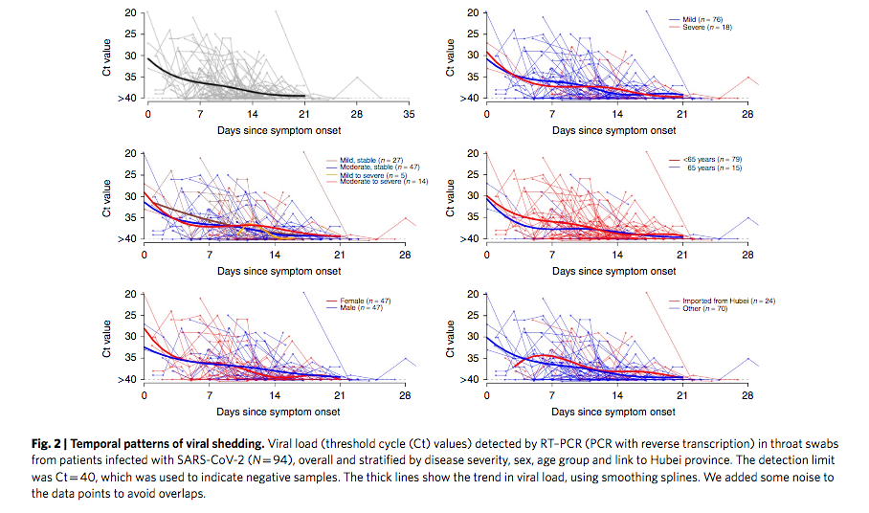
Nasopharyngeal Viral RNA Load Peaks Early
94 patients with laboratory-confirmed COVID-19 admitted in China
Most moderately ill, none severe
No difference in viral loads across sex, age groups, disease severity
He X, et al. Nat Med. 2020 May;26(5):672-675. doi: 10.1038/s41591-020-0869-5.

Slide 11
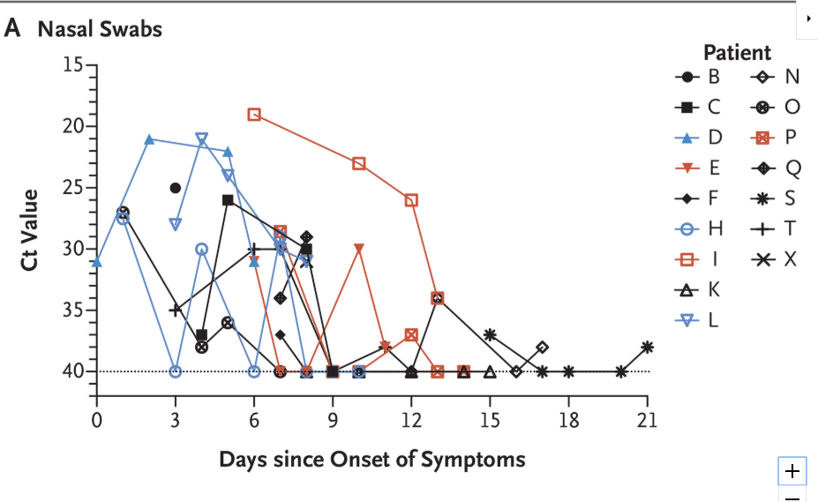
Nasopharyngeal Viral RNA Load Peaks Early
SARS-CoV-2 viral loads in upper respiratory tract from patients in 2 family clusters
Higher viral RNA loads detected soon after symptom onset
Viral RNA load in an asymptomatic patient similar to symptomatic patients
Zou L, et al. N Engl J Med. 2020 Mar 19;382(12):1177-1179. doi: 10.1056/NEJMc2001737.

Slide 12
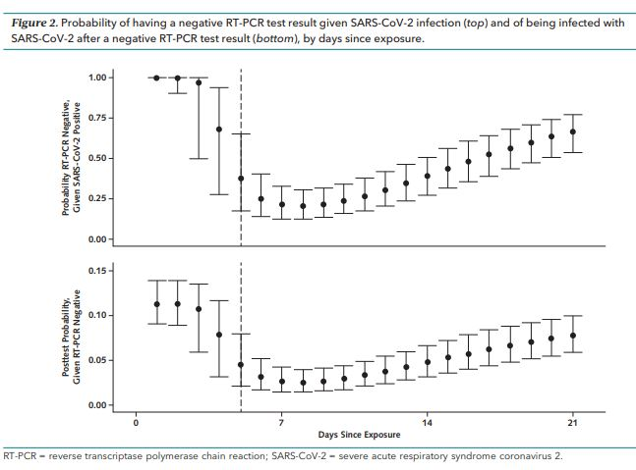
Nasopharyngeal Viral RNA Load and Symptoms
Pooled analysis of literature review of 7 studies on upper respiratory RT-PCR performance by time since symptom onset (n = 1330)
Typical time of symptom onset post infection: 5 days
Day 1 of infection probability of false negative result = 100% (95% CI, 100% -100%)
Day 5 (day of symptom onset) median false-negative rate 38% (CI, 18% - 65%)
Day 8 (3 days after symptom onset) =20% (CI, 12% - 30%)
Kucirka LM, et al. Ann Intern Med. 2020 May 13;M20-1495. doi: 10.7326/M20-1495.

Slide 13
Time From Symptom Onset and Infectiousness
Prospective case-ascertained study in Taiwan of confirmed cases of COVID-19 and contacts
All close contacts quarantined for 14 days after last exposure to index case.
Any relevant symptoms of contacts triggered COVID-19 test.
100 confirmed patients, median age of 44 years (IQR 11-88 years), 2761 close contacts
Overall secondary clinical attack rate 0.7% (95% CI, 0.4%-1.0%).
Cheng HY, et al. JAMA Intern Med. 2020 May 1;180(9):1156-1163. doi: 10.1001/jamainternmed.2020.2020.

Slide 14
Time From Symptom Onset and Infectiousness
Cheng HY, et al. JAMA Intern Med. 2020 May 1;180(9):1156-1163. doi: 10.1001/jamainternmed.2020.2020.

Slide 15
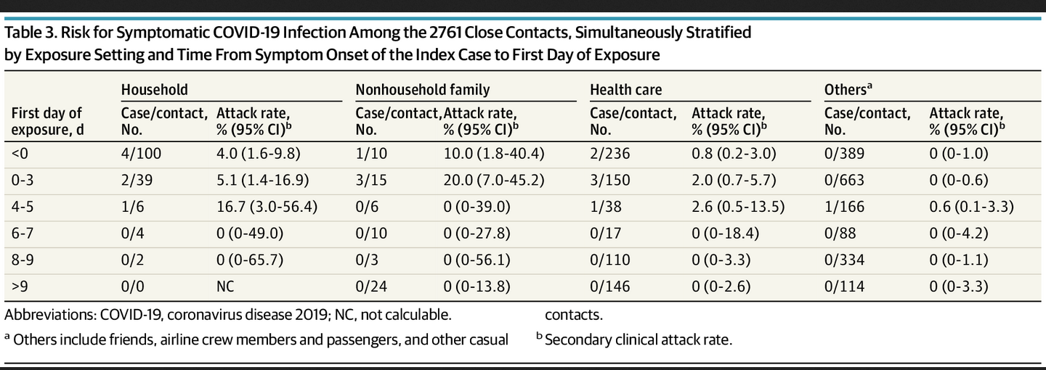
Time From Symptom Onset and Infectiousness
0 cases from 852 contacts if exposed after 5 days from symptom onset of index case
299 contacts with exclusive presymptomatic exposures also at risk (attack rate, 0.7%)
Cheng HY, et al. JAMA Intern Med. 2020 May 1;180(9):1156-1163. doi: 10.1001/jamainternmed.2020.2020.
Notes:
Prospective case-ascertained study in Taiwan of confirmed cases of COVID-19 and contacts
All close contacts quarantined for 14 days after last exposure to index case.
Any relevant symptoms of contacts triggered COVID-19 test.
100 confirmed patients, median age of 44 years (IQR 11-88 years), 2761 close contacts
Overall secondary clinical attack rate 0.7% (95% CI, 0.4%-1.0%).

Slide 16
Nasopharyngeal Viral RNA Load and Viral Culture
9 patients in an epidemiologic cluster in Germany.
Average virus RNA load 6.76 × 10⁵ copies per whole swab until day 5
Swab samples taken after day 5 had average viral load 3.44 × 10⁵ copies/swab
Virus isolated during first week of symptoms in 16.66% of swabs and 83.33% of sputum samples
No virus isolated from samples taken after day 8
Once qRT-PCR dropped below 10^6 copies/mL virus is no longer isolated
Wolfel R, et al. Nature 2020 Apr 1. doi: 10.1038/s41586-020-2196-x.

Slide 17
Nasopharyngeal Viral RNA Load and Viral Culture
477 patients in South Korea with COVID-19, discharged with negative RT-PCRs, positive again after isolation discontinued
Successful contact tracing and epidemiologic investigation completed on 285 of the 477
790 contacts (351 family members) identified, followed for 14 days from exposure
https://www.cdc.go.kr/board/board.es?mid=a30402000000&bid=0030&act=view&list_no=367267&nPage=1

Slide 18
Nasopharyngeal Viral RNA Load and Viral Culture
44.9 days (IQR 8-82 days) from initial symptom onset to re-testing positive
14.3 days (IQR days) from discharge to testing positive.
Respiratory viral cultures attempted in 108 cases; none successful
3/790 contacts developed COVID-19, all traced to the Shincheonji religious group outbreak or a different family member
https://www.cdc.go.kr/board/board.es?mid=a30402000000&bid=0030&act=view&list_no=367267&nPage=1

Slide 19
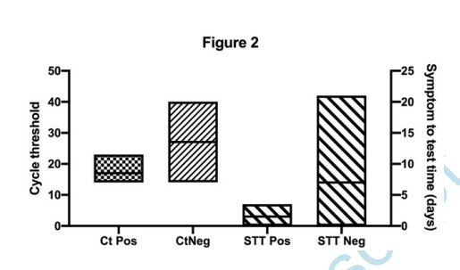
Nasopharyngeal Viral RNA Load, Symptoms, and Viral Culture
Retrospective cross-sectional study
Samples from persons tested between 0-21 days post symptom onset
Ninety RT-PCR SARS-CoV-2 positive samples incubated on Vero cells
Twenty-six samples (28.9%) demonstrated viral growth
No growth in samples with a Ct > 24 or symptoms to test time of > 8 days
Bullard J, et al. Clin Infect Dis. 2020 May 22;ciaa638. doi: 10.1093/cid/ciaa638.

Slide 20
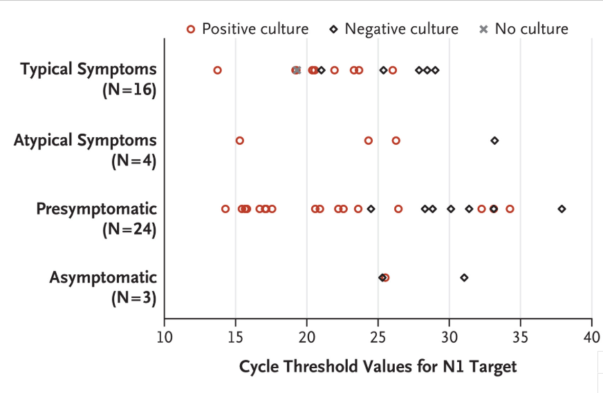
Nasopharyngeal Viral RNA Load, Symptoms, and Viral Culture
Epidemiologic study in skilled nursing facility
After case identified 2 point prevalence surveys, 1 week apart
76 of 89 residents participated
48 (63%) tested positive, 27 (56%) of which were asymptomatic at the time of testing
24 subsequently developed symptoms
Median RT-PCR cycle threshold value of 23.1
Viable virus recovered from 17 residents
Aarons MM, et al. N Engl J Med. 2020 Apr 24;NEJMoa2008457. doi: 10.1056/NEJMoa2008457.

Slide 21
Nasopharyngeal Viral RNA Load, Ct Value, Viral Culture
129 patients with severe or critical COVID-19
69% ICU, 8.5% severely immune compromised
23 (17.8%) infectious virus shedding
Duration of infectious virus shedding range 0 to 20 days post symptom onset (median 8 days, IQR 5 –11).
The probability of detecting infectious virus dropped below 5% after 15 days post onset of symptoms (95% CI 13.4 –17.2)
Van Kampen JA, et al. https://www.medrxiv.org/content/10.1101/2020.06.08.20125310v1

Slide 22
Nasopharyngeal Viral RNA Load, Ct Value, Viral Culture
Van Kampen JA, et al. https://www.medrxiv.org/content/10.1101/2020.06.08.20125310v1

Slide 23
Van Kampen JA, et al. https://www.medrxiv.org/content/10.1101/2020.06.08.20125310v1

Slide 24
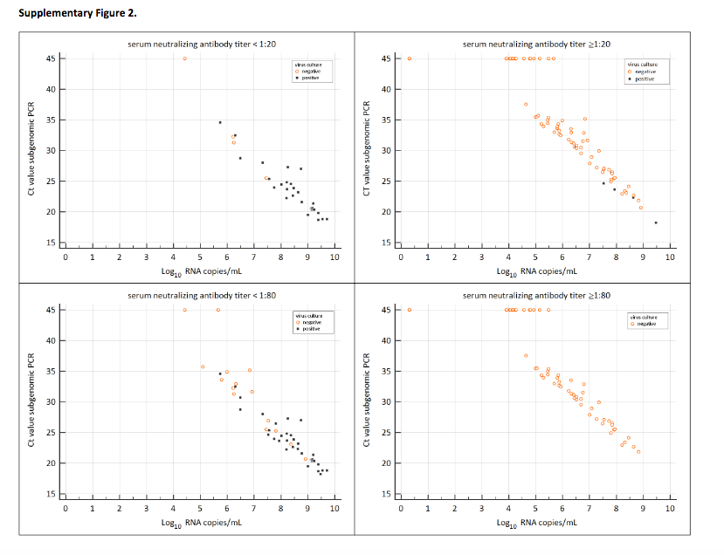
Van Kampen JA, et al. https://www.medrxiv.org/content/10.1101/2020.06.08.20125310v1

Slide 25
Nasopharyngeal Viral RNA Load, Ct Value, Viral Culture
Upper respiratory tract samples from persons with suspected COVID-19 tested at national respiratory virus reference laboratory, Public Health England
In first 3 months of the COVID-19 pandemic in UK → 754 URT samples from 425 symptomatic cases tested
Had clear record of the dates of symptom onset and sample collection
Samples collected as part of the First Few 100 surveillance study
Singanayagam A. et al. Euro Surveill. 2020 Aug;25(32):2001483. doi: 10.2807/1560-7917.ES.2020.25.32.2001483.

Slide 26
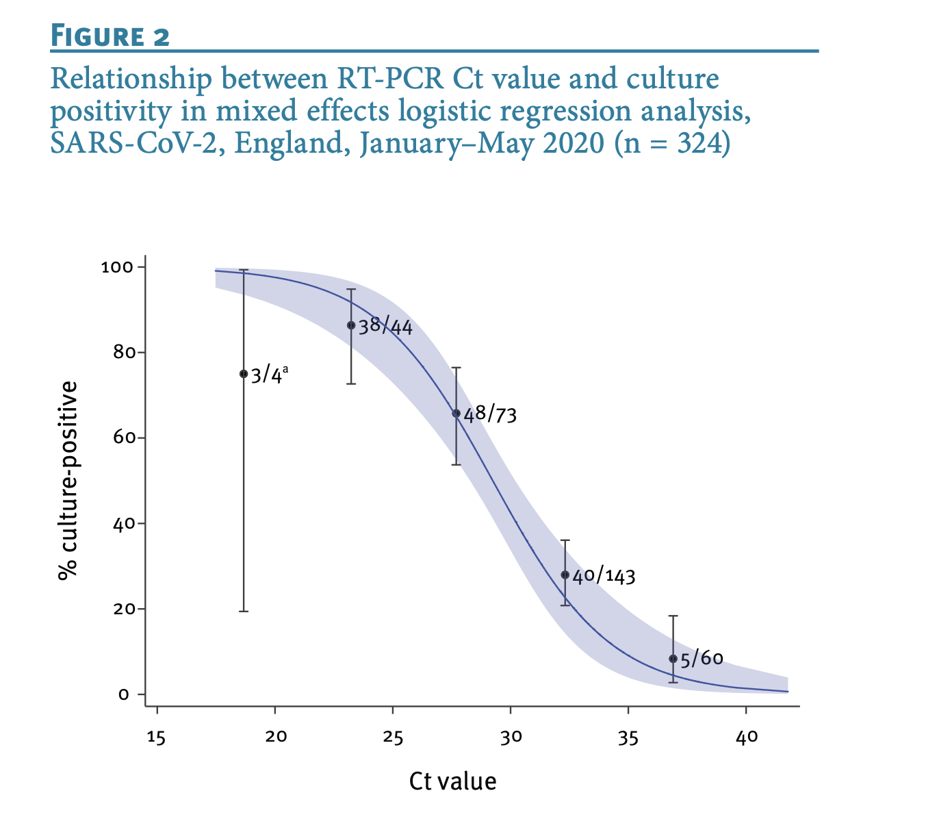
Nasopharyngeal Viral RNA Load, Ct Value, Viral Culture
Singanayagam A. et al. Euro Surveill. 2020 Aug;25(32):2001483. doi: 10.2807/1560-7917.ES.2020.25.32.2001483.
Notes:
Upper respiratory tract samples from persons with suspected COVID-19 tested at national respiratory virus reference laboratory, Public Health England
In first 3 months of the COVID-19 pandemic in UK → 754 URT samples from 425 symptomatic cases tested
Had clear record of the dates of symptom onset and sample collection
Samples collected as part of the First Few 100 surveillance study

Slide 27
Nasopharyngeal Viral RNA Load, Ct Value, Viral Culture
Singanayagam A. et al. Euro Surveill. 2020 Aug;25(32):2001483. doi: 10.2807/1560-7917.ES.2020.25.32.2001483.

Slide 28
Key Points
Upper respiratory viral load peaks early, decreases precipitously after symptom onset (in symptomatic and asymptomatic)
Mild to moderate disease → SARS-CoV-2 not cultured 10-12 days post symptom onset, even with positive RT-PCR
Severe/Critical or severely immune compromised: up to 20 days
Ct value appears to correlate to likelihood of culture positivity
Caveat: viral culture insensitive, but best surrogate marker we have of infectivity

Slide 29
Mitigation of transmission

Slide 30
Questions
What data exist to support specific mitigation methods such as
Masks
Physical distancing
Eye protection
What data exist to support various mitigation methods in
The community
Healthcare settings
The home

Slide 31
Asymptomatic Transmission
Outbreak in LTCF in Washington
CDC symptom assessments and SARS-CoV-2 testing for 76/82 (93%) residents
Among 23 (30%) residents with positive test results, 10 (43%) had symptoms on the date of testing, 13 (57%) were asymptomatic.
7 days after testing, 10/13 previously asymptomatic residents developed symptoms → presymptomatic
No significant differences between the mean Ct values in four symptom status groups (p = 0.3).
RT-PCR Ct) values: 18.6 to 29.2 (symptomatic, typical) 15.3 to 37.9 (presymptomatic), and 21.9 to 31.0 (asymptomatic)
Kimball A, et al. MMWR Morb Mortal Wkly Rep 2020 Apr 3;69(13):377-381. doi: 10.15585/mmwr.mm6913e1.

Slide 32
Asymptomatic Transmission
Diamond Princess Cruise Ship
3,700 passengers and crew
On 1/25 symptomatic passenger departed, diagnosed with COVID-19
2/3 → ship quarantined
Initially symptomatic and close contacts tested
Testing later expanded
712 (19.2%) positive for SARS-CoV-2
331 (46.5%) asymptomatic at time of testing
Modeling estimates true asymptomatic cases 18%
Moriarty LF, et al. MMWR Morb Mortal Wkly Rep 2020;69:347-352
https://www.nytimes.com/2020/02/06/world/asia/coronavirus-cruise-ship.html

Slide 33
Asymptomatic Transmission
Review of all cases in Singapore
Seven clusters where presymptomatic transmission likely occurred
10 asymptomatic cases within clusters account for 6.4% cases
Four clusters for which the date of exposure could be determined
Presymptomatic transmission occurred 1–3 days before symptom onset
Wei We, et al. MMWR Morb Mortal Wkly Rep. ePub: 1 April 2020

Slide 34
Mitigation Measures and Transmission: Community
Trends in COVID-19 Incidence After Implementation of Mitigation Measures in Arizona
Numbers of daily cases and 7-day moving averages relative to implementation of enhanced community mitigation measures examined
Average number of daily cases increased 151%, from 808 on June 1, 2020 to 2,026 on June 15, 2020 (after stay-at-home order lifted) → increased preventive measures.
Gallaway MS, et al. MMWR Morb Mortal Wkly Rep . 2020 Oct 9;69(40):1460-1463.. doi: 10.15585/mmwr.mm6940e3.

Slide 35
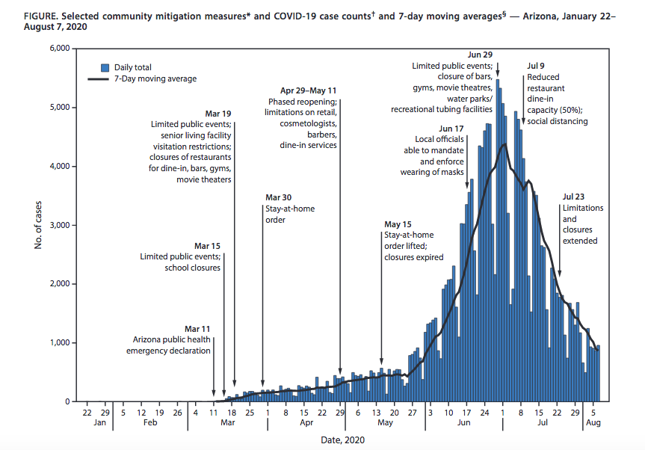
Number of cases peaked June 29–July 2
Stabilized July 3–July 12
Further declined by 75% July 13–August 7.
7-day moving avg daily cases peaked June 29–July 2
Stabilized July 3–12 Decreased 75% from July 13 to August 7.
Gallaway MS, et al. MMWR Morb Mortal Wkly Rep . 2020 Oct 9;69(40):1460-1463.. doi: 10.15585/mmwr.mm6940e3.
Notes:
June 17, local officials began implementing and enforcing mask wearing (via county and city mandates) → 85% of the state population
Limitation of public events
Closures of bars, gyms, movie theaters, and water parks
Reduced restaurant dine-in capacity
Voluntary resident action to stay at home and wear masks (when and where not mandated).

Slide 36
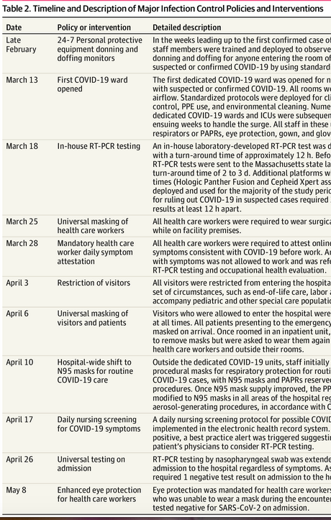
Mitigation Measures and Transmission: Hospitals
9149 patients admitted to a large US academic medical center between March-May
Examined all patients with COVID-19 for whom the first positive RT-PCR test result occurred on hospital day 3 or later
Rhee C, et al. JAMA Netw Open. 2020 Sep 1;3(9):e2020498. doi: 10.1001/jamanetworkopen.2020.20498.

Slide 37
Mitigation Measures and Transmission: Hospitals
697 COVID-19 cases were confirmed
Twelve (1.7%) first tested positive on hospital day 3 or later (median, 4 days; range, 3-15 days).
1 case was deemed to be hospital acquired, most likely from a presymptomatic spouse before visitor restrictions and masking implemented
Among 8370 patients with non–COVID-19–related hospitalizations discharged 11 (0.1%) tested positive within 14 days
1 case was deemed likely to be hospital acquired, albeit with no known exposures.
Rhee C, et al. JAMA Netw Open. 2020 Sep 1;3(9):e2020498. doi: 10.1001/jamanetworkopen.2020.20498.

Slide 38
Mitigation Measures and Transmission: Hospitals
Rhee C, et al. JAMA Netw Open. 2020 Sep 1;3(9):e2020498. doi: 10.1001/jamanetworkopen.2020.20498.
Notes:
697 COVID-19 cases were confirmed
Twelve (1.7%) first tested positive on hospital day 3 or later (median, 4 days; range, 3-15 days).
1 case was deemed to be hospital acquired, most likely from a presymptomatic spouse before visitor restrictions and masking implemented
Among 8370 patients with non–COVID-19–related hospitalizations discharged 11 (0.1%) tested positive within 14 days
1 case was deemed likely to be hospital acquired, albeit with no known exposures.

Slide 39
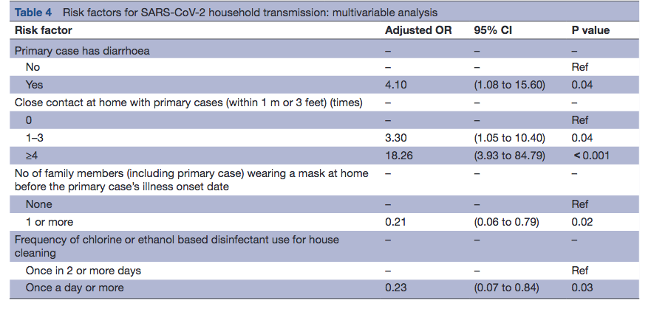
Mitigation Measures and Transmission: Households
Wang Y, et al. BMJ Glob Health. 2020 May;5(5):e002794. doi: 10.1136/bmjgh-2020-002794.
Notes:
Retrospective cohort study of 335 people in 124 families and with at least one laboratory confirmed COVID-19 case in China
Examined secondary attack rate, characteristics of patients, characteristics of well family members
Patient and family member interviews

Slide 40
Other Data for Mitigation: Masks

Slide 41
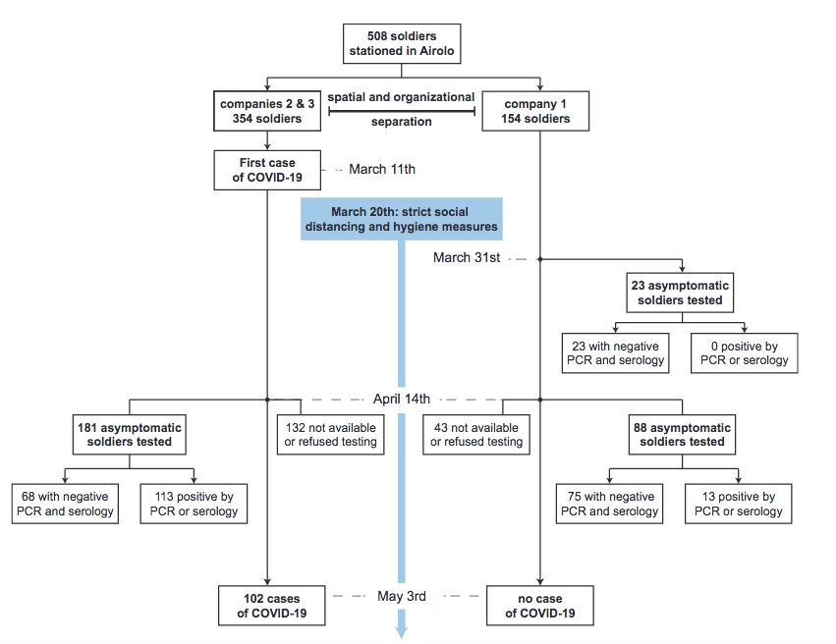
Mitigation: Distancing, Masks
Bielecki M, et al. Clin Infect Dis. 2020 Jun 29;ciaa889. doi: 10.1093/cid/ciaa889.

Slide 42
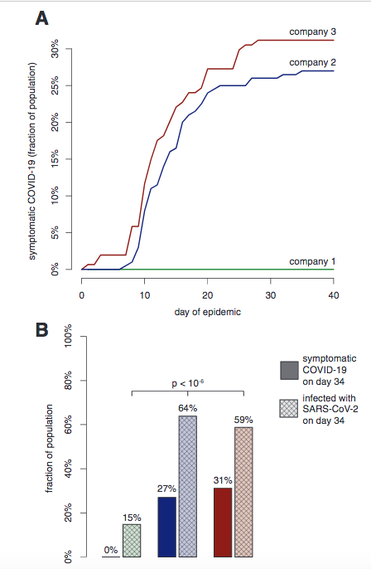
Mitigation: Distancing, Masks
Bielecki M, et al. Clin Infect Dis. 2020 Jun 29;ciaa889. doi: 10.1093/cid/ciaa889.

Slide 43
Other Data for Mitigation: Distancing
Survey of 1,030 people in Maryland
Median age of the sample was 43 years.
96% had traveled outside of their homes unrelated to work
55 participants (5.3%) self-reported testing positive for SARS-CoV-2
In multivariable analysis, infection was negatively associated with always practicing social distancing
aOR for indoor social distancing: 0.32; 95% CI: 0.10 –0.98
aOR for outdoor social distancing: 0.10; 95% CI: 0.03 –0.33
Clipman, SJ et al. Clin Infect Dis. 2020 Sep 2;ciaa1313. doi: 10.1093/cid/ciaa1313.

Slide 44
Other Data for Mitigation: Eye Protection
Community health workers in a research network in India
Counseled and tested asymptomatic family contacts of persons with diagnosed COVID-19
Did not have exposure to each other and did not go home or to public places.
Were masked and practiced social distancing while engaging with family members
Tested for SARS-CoV-2 weekly.
Before face shields, 62 workers visited 5880 homes → 222 people positive tests
12 healthcare workers (19%) infected
After face shields, 50 workers visited 18,228 homes → 2,682 positive
No healthcare workers were infected during this time.
Bhaskar ME, Santhanam A. JAMA. 2020 Oct 6;324(13):1348-1349. doi: 10.1001/jama.2020.15586.

Slide 45
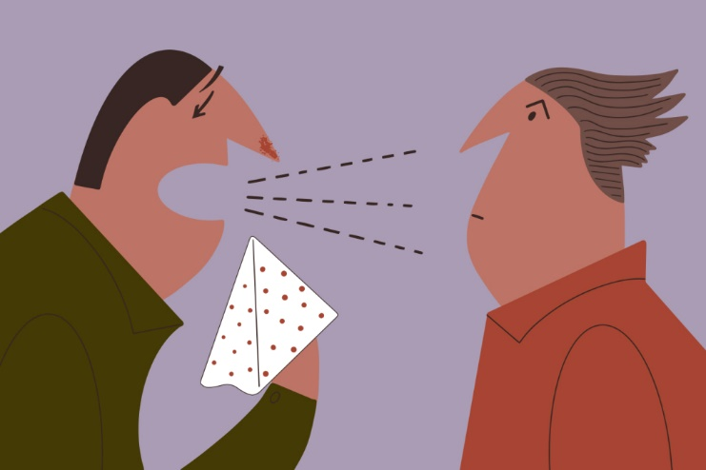
CDC Updates Close Contact Definition
Case at Vermont correctional facility
6 individuals eventually diagnosed with COVID-19
Correctional officer diagnosed: no known other contact, no travel, cases in Vermont 20/100,000
Was not within 6 feet of any of the individuals for a 15-minute period
Was within 6 feet of the infected individuals at least 22 times→ 17 minutes over the course of an 8-hour shift.
Pringle JC, et al. MMWR Morb Mortal Wkly Rep. ePub: 21 October 2020. DOI: http://dx.doi.org/10.15585/mmwr.mm6943e
https://californiahealthline.org/news/when-it-comes-to-the-new-coronavirus-just-who-is-a-close-contact/

Slide 46
CDC Updates Close Contact Definition
Then:
“Someone who was within 6 feet of an infected person for at least 15 minutes starting from 2 days before illness onset (or, for asymptomatic patients, 2 days prior to specimen collection) until the time the patient is isolated.”
Now:
“Someone who was within 6 feet of an infected person for a cumulative total of 15 minutes or more over a 24-hour period starting from 2 days before illness onset (or, for asymptomatic patients, 2 days prior to test specimen collection) until the time the patient is isolated.”
https://www.cdc.gov/coronavirus/2019-ncov/php/contact-tracing/contact-tracing-plan/appendix.html#contact

Slide 47
Key Points
Asymptomatic transmission occurs, cannot rely on symptoms to drive mitigation practices
Observational data supports community, hospital, home-based use of masks and distancing to reduce SARS-CoV-2 transmission
Observational data supports use of eye protection to reduce SARS-CoV-2 transmission
RCT data from 2 trials on masks forthcoming

Slide 48
Key Points
Upper respiratory viral load peaks early, decreases precipitously after symptom onset (in symptomatic and asymptomatic)
Mild to moderate disease → SARS-CoV-2 not cultured 10-12 days post symptom onset, even with positive RT-PCR
Severe/Critical or severely immune compromised: up to 20 days
Ct value appears to correlate to likelihood of culture positivity
Caveat: viral culture insensitive, but best surrogate marker we have of infectivity

Slide 49
Objectives
Discuss data on timing of peak infectiousness
Viral dynamics
Data on symptoms and correlation to culture positivity
Ct value correlation to culture positivity
Describe data on masks, distancing, eye protection mitigation measures in
Community
Healthcare Settings
Home

