Slide 1
2023 IDAC
37th Annual Spring Symposium
May 6 - 7, 2023
Huntington Beach

Slide 2
2023 Spring Symposium
Disclosures of Financial Relationships
CME Committee
Arash Heidari, MD: None
Philip Robinson, MD: Expert Stewardship (O); Hoag Hospital (C)
Ellie Goldstein, MD: Merck (AB, S); BioK (AB); Shionogi (AB, S); Acurx, (AB); Summit Pharm (AB) Kindred Hospital System (AB)
David Ha, PharmD: None
Jeffery Silvers, MD: None
Lisa Kilgore, BSBM, MBA-HC, CIC: None
Francesca Torriani, MD: None
James McKinnell, MD: Ferring (C); Expert Stewardship (O); Thermo Fisher (C)
Speakers
Christopher Graber, MD, MPH: None
Ashrit Multani, MBBS: None
Eric Daar, MD: Gilead (C), Merck (C), GSK/ViiV (C), Theratechnologies (C)
Charles Daley, MD: AN2 (C, G), Bugworks (G), Aztrazeneca (C), Genetech (C), Hyfe (C), Insamed (C, G), Paratek (C, G), Pfizer (C), Spero(C), Zambon (C), Renovion (G), Matinas (C), MannKind (C), Lilly (DMC), Otsuka (DMC).
Kathleen Stillwell, RN, Richard Cahill, EsqQ: None
Randy Taplitz, MD, MPH: Karius (C), Merck (C) Snipr Riomr (C)
Zachary Rubin, MD, MPH: None
John Perfect, MD: None
Ravina Kullar, PharmD, MPH - None
All relevant financial relationships have been mitigated

Slide 3
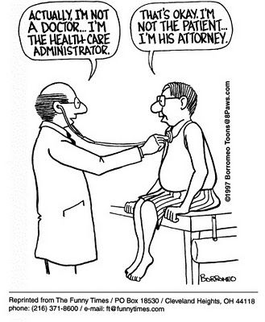
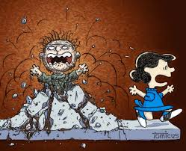

Slide 4
Spring 2023 SYMPOSIUM PROGRAM
Saturday, 5/6
08:30 Welcome, Dr. James McKinnell
08:40 Review of Top Publications From ID Week: Christopher Graber, MD MPH, FIDSA,
10:00 Screening and Prophylaxis of Infectious Diseases in Solid Organ Transplantation – Ashrit Multani, MBBS
11:00 HIV Update: Long Term Injectables – Eric Daar, MD
12:00 Lunch/Breakout Sessions/Industry Exhibits
12:15 Members Meeting
1315 Nontuberculous Mycobacterial Infections – Charles Daley, MD
14:30 Malpractice Risks for Infectious Disease Specialists - Kathleen Stillwell, RN, MPA, MHSA, CPHRM; Richard Cahill, Esq.
15:30 Immune Suppression and Monoclonals, Impact – Dr. Randy Taplitz, MD, FIDSA

Slide 5
Spring 2023 SYMPOSIUM PROGRAM
Sunday, May 7
08:30 Welcome, Dr. James McKinnell
08:40 C auris update – Zachary Rubin, MD, MPH
09:40 Break, Industry exhibit visits
10:00 Antifungal/Molds and Azole Resistance – John R. Perfect, MD
11:00 Speed Dating - New Antimicrobials - Ellie J.C. Goldstein, M.D. ; Ravina Kullar, PharmD, MPH, FIDSA
12:00 Symposium Ends

Slide 6
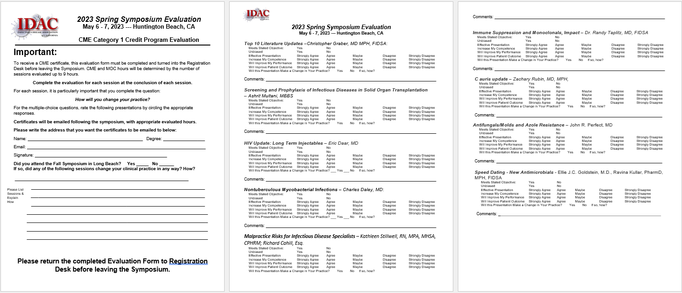
To Receive CME/CE/MOC Credit, You Must Return Your Completed Evaluation Forms.

Slide 7
Up to 6 CME/CE Credits for Each Session:
For each session it is particularly important that you complete the question:
How will you change your practice?
For the multiple-choice questions, rate the presentation by circling the appropriate responses.

Slide 8
Up to 6 MOC
points:
At least 3 full sentences…

Slide 9
Please consider making a tax-deductible donation to
IDAC’s endowment fund. Donation can easily be contributed via credit card, at our web site page:
www.idac@idac.org
With your help, IDAC will continue
to be the premier regional infectious disease
society, providing quality meetings with nationally renowned speakers and wonderful opportunities to network.
Thank you for your support.

Slide 10
Slides are available at:
https://idac.org/Past-Events
WiFi Access
Network Name: IDAC Access Code: spring2023

